Slide 1
Lesson 4
American History
B: 1800s ►Civil War
Questions: 60, 9, 3, 2, 11, 72, 73, 74, 76, 75
1

Slide 2
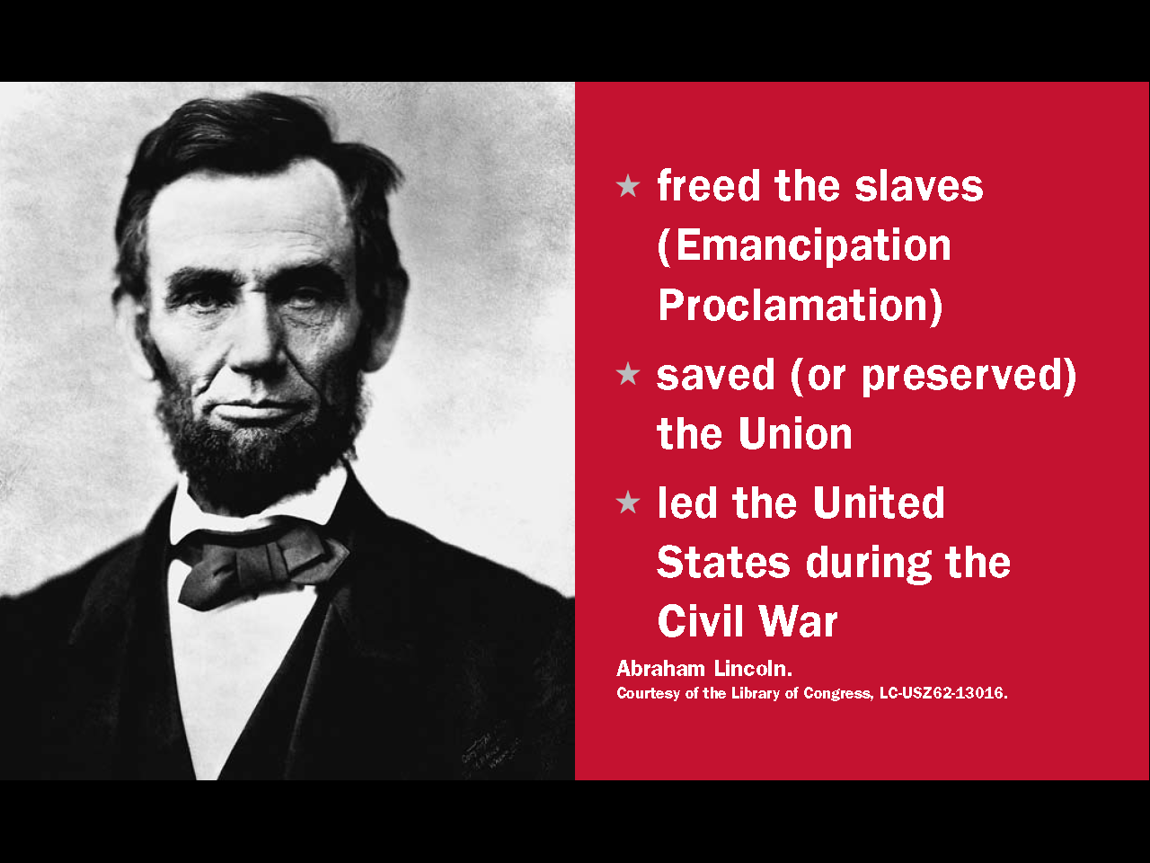
Abraham Lincoln

Slide 3
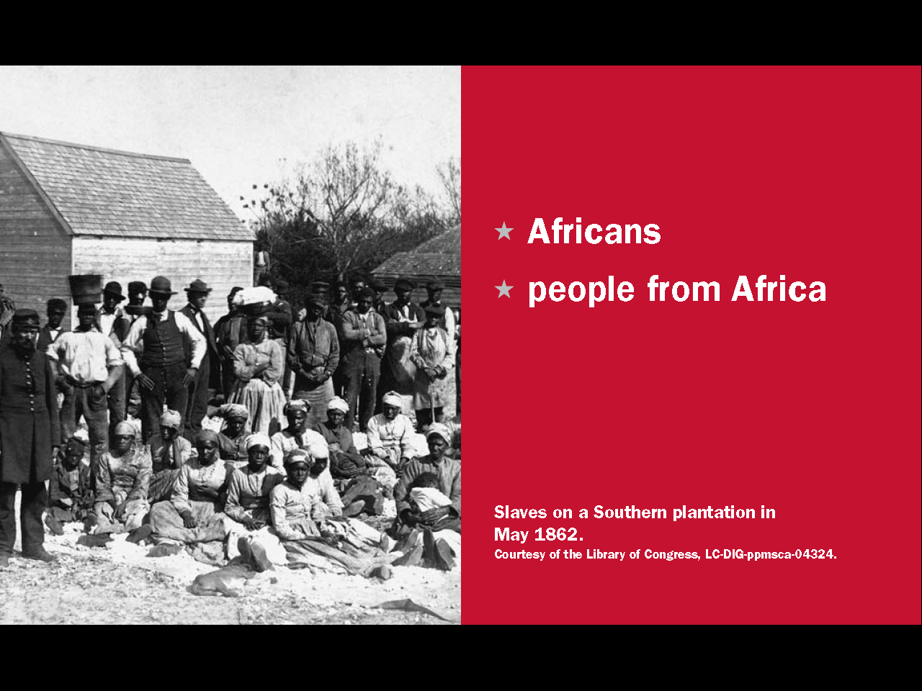
Question # 60

Slide 4
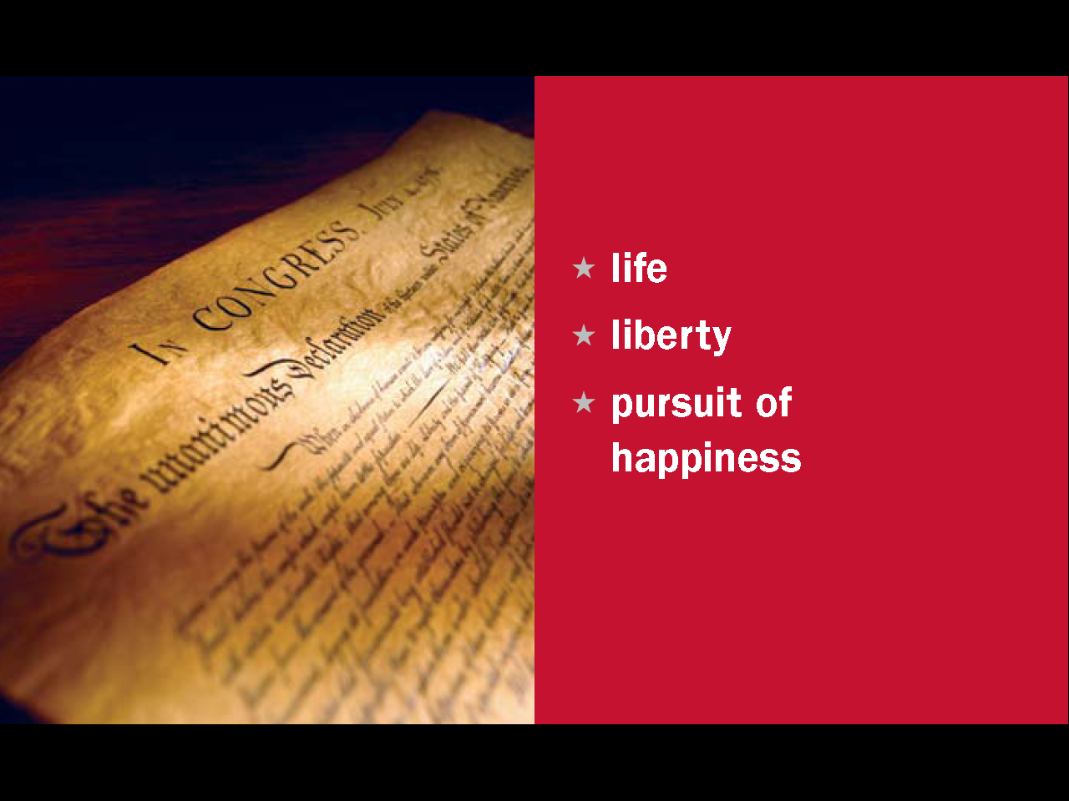

Slide 5
Question # 9

Slide 6
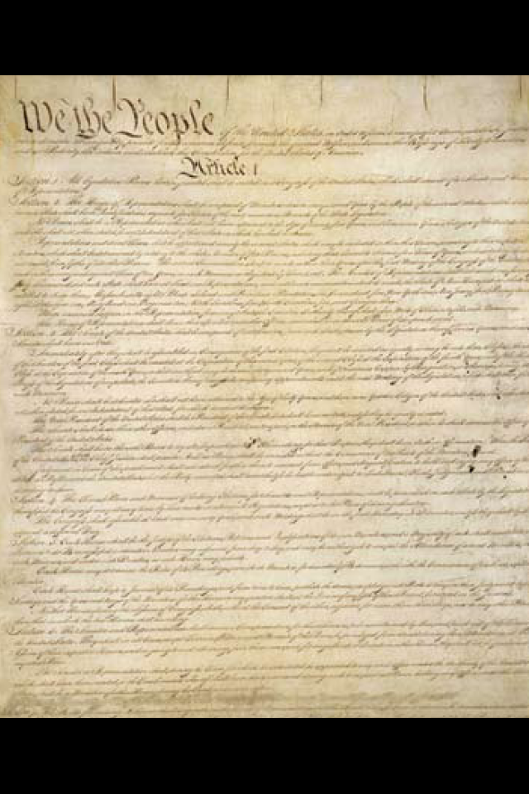

Slide 7
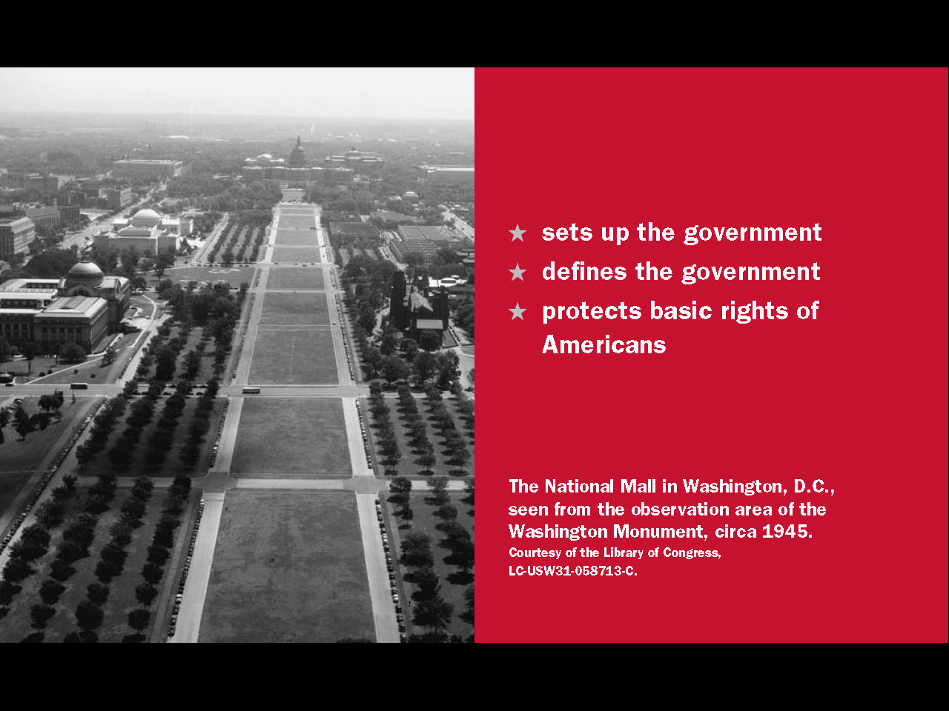
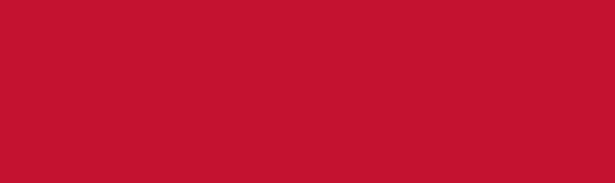
Question # 2

Slide 8
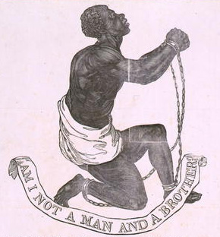

Slide 9
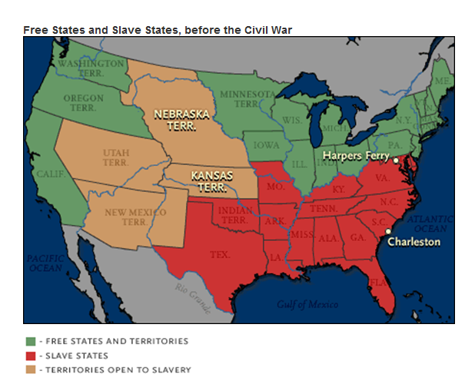

Slide 10
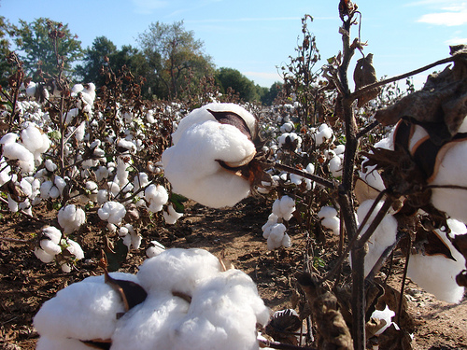
Cotton, Slavery and the Economy of the Southern States

Slide 11
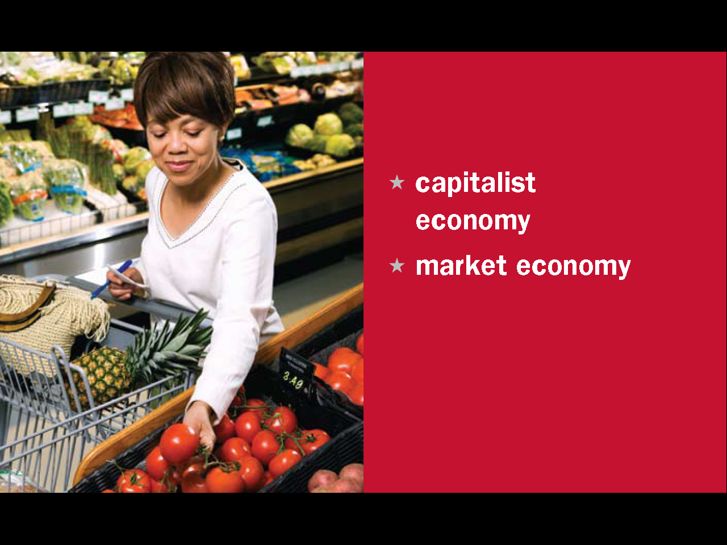
Question # 11

Slide 12
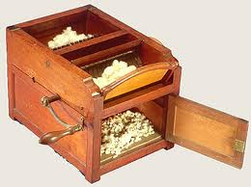
The Cotton Gin

Slide 13
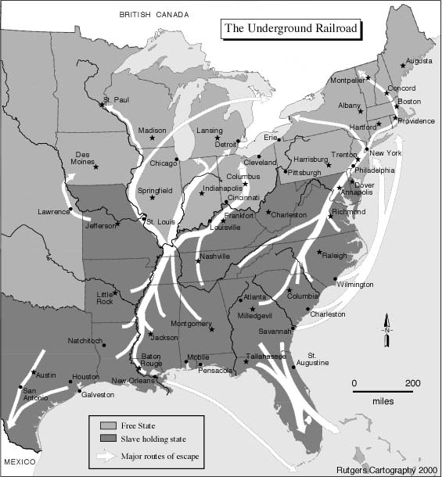
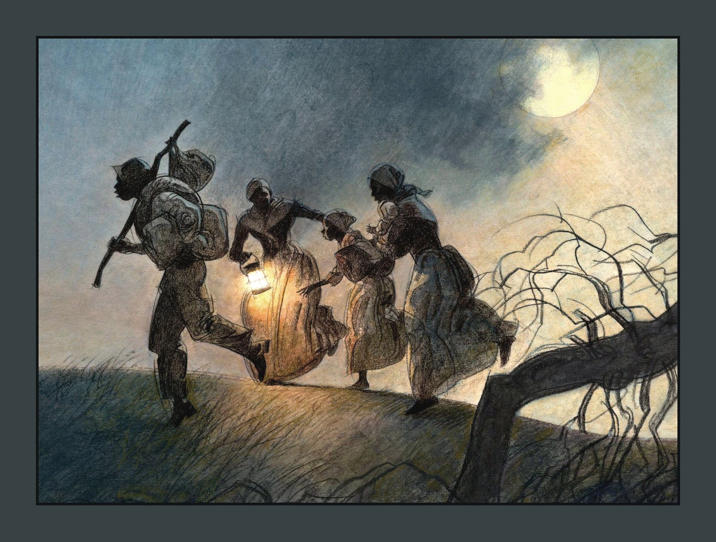

Slide 14
President Abraham Lincoln - 1861

Slide 15
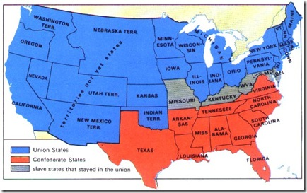

Slide 16
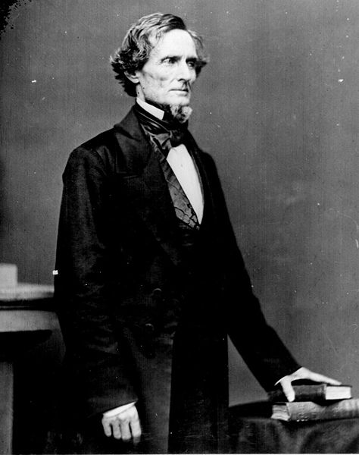
The 2 Presidents of the United States

Slide 17
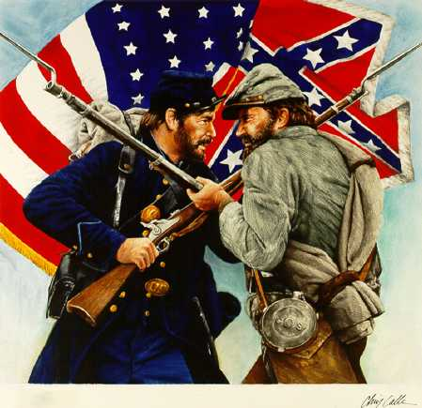
1861-1865

Slide 18
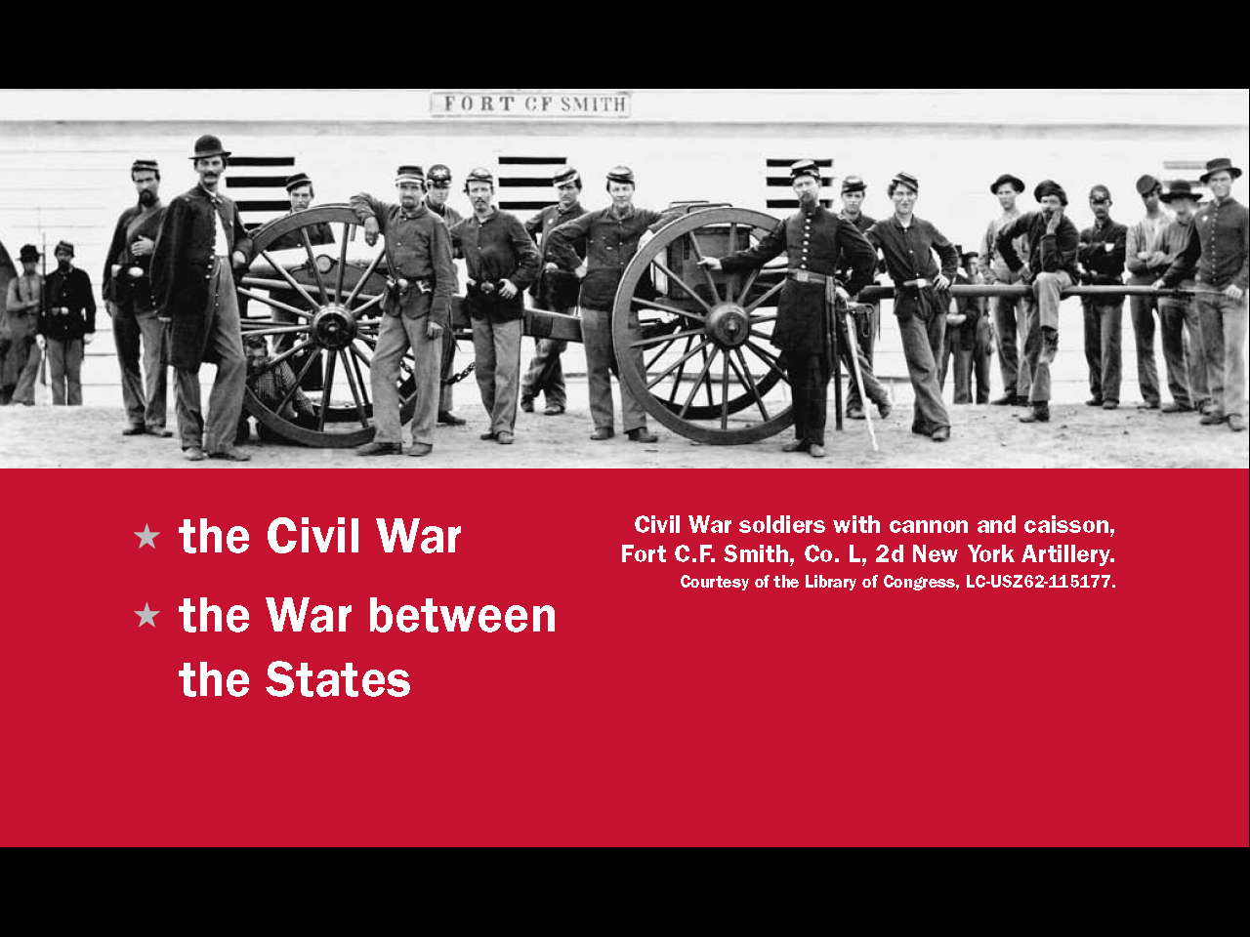
Question # 73

Slide 19
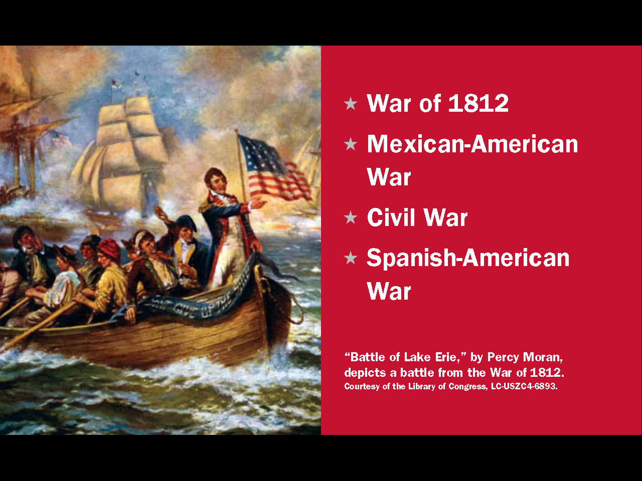
Question # 72

Slide 20
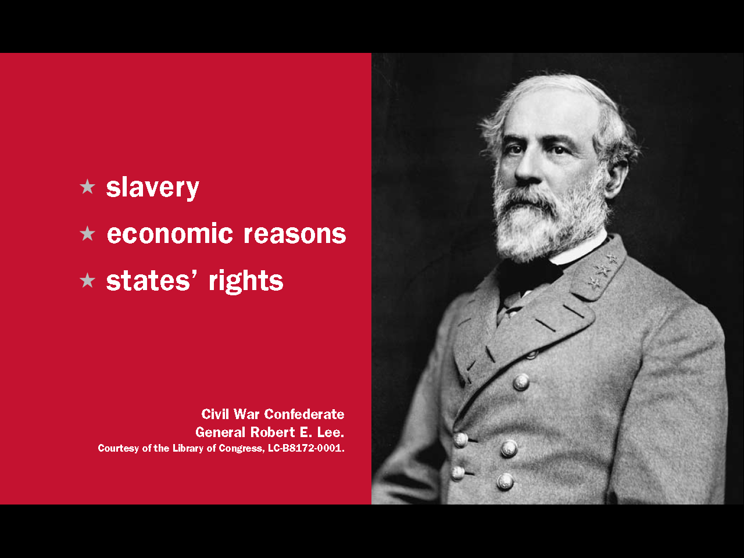
Question # 74

Slide 21
Emancipation Proclamation

Slide 22
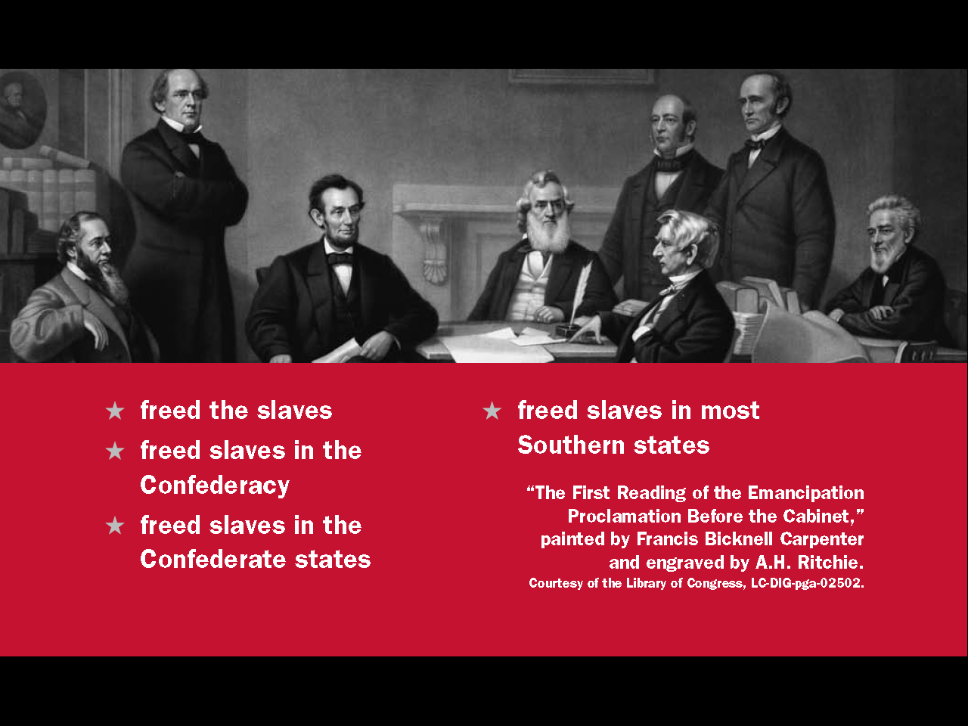
Question # 76

Slide 23
Question # 75

